Slide 1
BUSINESS DATA MANAGEMENT
CAPSTONE PROJECT
Case Study of Shiv Shakti Mill
Name : DIGPAL SINGH
Roll No : 21F3001362
Email: 21f3001362@ds.study.iitm.ac.in

Slide 2

Content
Executive Summary
Data collection and cleaning
Data analysis
Findings
Recommendation

Slide 3

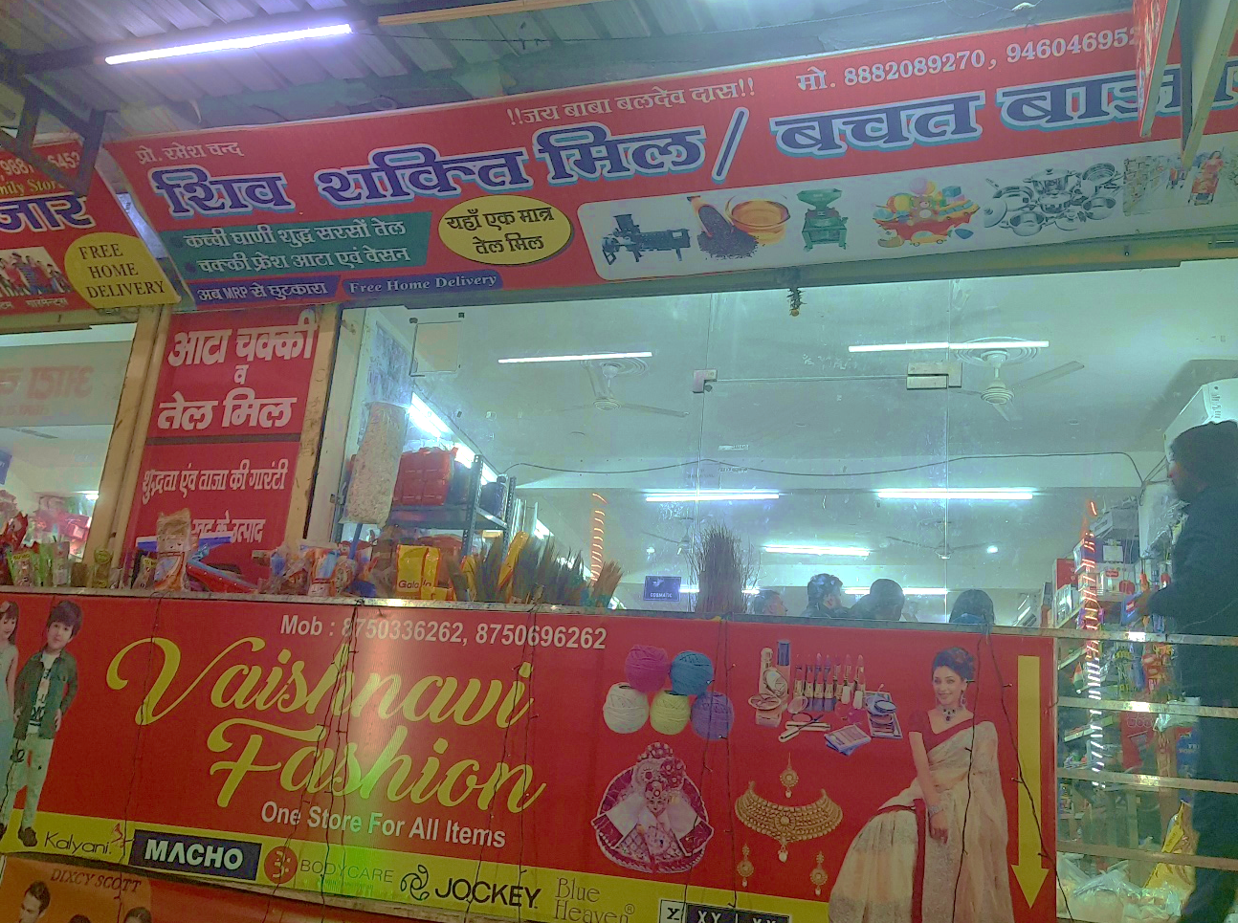
01. Executive Summary
The medium-sized general-purpose departmental store, founded by Mr. Ramesh Yadav in the year 2017, primarily offers a wide array of everyday essentials such as cereals, grains, pulses, oils, milk, and dairy products.
Regrettably, the store has been grappling with difficulties pertaining to:
Financial Performance: The store has faced hurdles in sustaining profitability and achieving desired sales targets.
Inventory Control: Challenges have arisen concerning the effective management and optimization of inventory levels to meet customer demand efficiently.

Slide 4

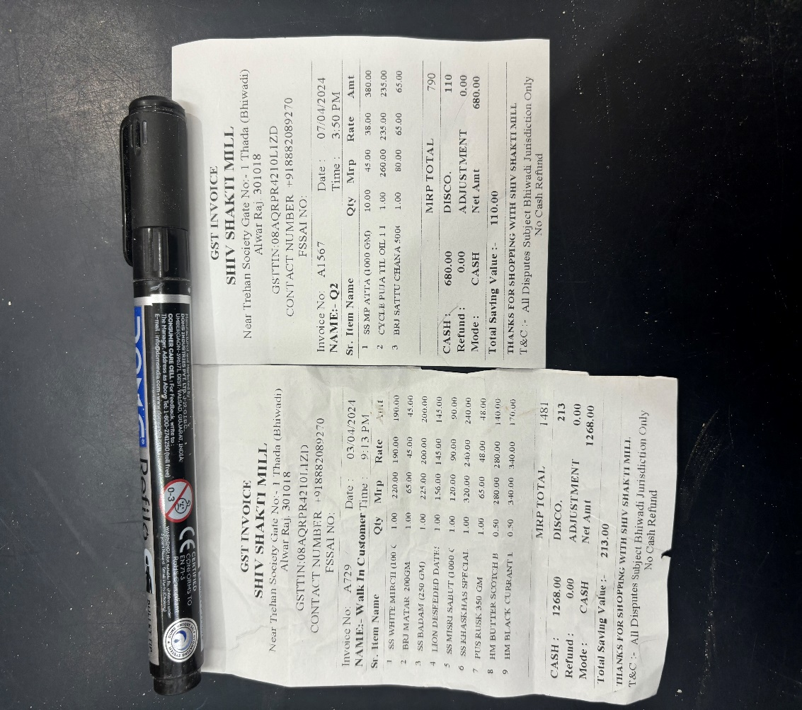
02. Data collection & cleaning
To gather data, I conducted daily visits to the store over a span of 31 days, meticulously documenting sales figures, purchase quantities, prices, and inventory levels for 15 selected items.
Given the raw nature of the primary data collected, I utilized Google Sheets/Excel for data consolidation and cleansing, preparing it for comprehensive analysis and future use.

Slide 5

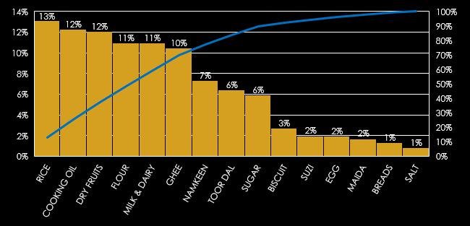
03. Data analysis (3.1 Sales…)
Highest revenue generating week : 4th
Average daily revenue : ₹ 26,027
Minimum revenue : ₹ 17,681
Maximum revenue : ₹ 36,439
Deviation : ₹ 4,779.87
Range : ₹ 18,758
Total revenue : ₹ 8,06,846
Total Revenue each item/month
Total Revenue each item/month
Revenue Trend Over Month
Rice, Cooking Oil, Dry Fruits, Flour, Milk & Dairy and Ghee are the main revenue generating items of the store

Slide 6
03. Data analysis (3.2 Purchase…)
TOOR DAAL PURCHASE Vs CP
Purchase Price Trend Over Month
DRY FRUITS PURCHASE Vs CP
Purchase price slightly up in mid of the month
Dry fruits purchase price shows dip in the trend at the end of the month
Toor Daal purchase price shows slight up trend after mid of the month
owner could increase the profit by early purchasing of “Toor Daal” and slightly delay or early purchasing of “Dry Fruits”

Slide 7
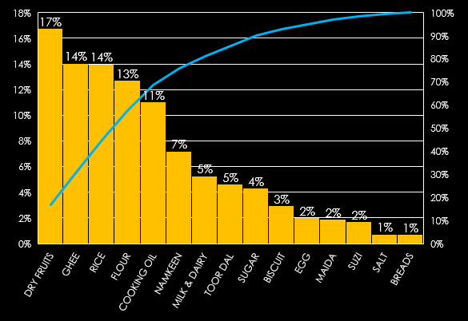
03. Data analysis (3.3 Profit/Loss…)
Avg. Purchase Vs Selling Price
Pareto (Total Profit)
Profit Analysis
“Dry Fruits” and “Ghee” are the maximum profit generating items
“Dry Fruits” and “Ghee” sales volume need to be improved to increase store’s net profit
76% contribution to the profit is from Dry fruits, Ghee, Rice, Flour, Cooking oil and Namkeen

Slide 8
03. Data analysis (3.4 Inventory…)
Inventory Fluctuation
AVG Sales Vs Stock IN STORE
There is no abnormality except “Breads”.
Rice, Flour and other items inventory is high, need to optimize the same to increase the net profit margin.
There is no abnormality in average stock w.r.t sales, however, fluctuations are high in inventory for most of the items and slight dip in trend is visible after mid of the month which indicates poor planning and validate the owner’s claim of tedious task to maintain the inventory

Slide 9

04. Findings (PL & Insights…)
FIXED COST ANALYSIS
 | COST | RATE OF DEPRICIATION | DEPRICIATION
FURNITURE | 800000 | 1% | ₹8,000
FREEZER | 120000 | 2% | ₹2,400
CONTAINERS | 80000 | 1% | ₹800
DELIVERY VEHICLES | 80000 | 5% | ₹4,000
PETROL/TRANSPORT | 5000 | 100% | ₹5,000
RENT | 35000 | 100% | ₹35,000
ELECTRICITY | 15000 | 100% | ₹15,000
CARRY BAGS | 3000 | 100% | ₹3,000
TOTAL FIXED COST | ₹11,38,000 | TOTAL NORMALISED FIXED COST | ₹73,200
BALENCE SHEET AND KEY INSIGHTS
VARIABLES | VALUE | IDEAL NUMBERS | REMARK
TOTAL REVENUE | ₹8,06,846 | Much is better | GOOD CONSIDERING CURRENT INFRA
VARIABLE COSTS | ₹7,05,609 | Less is better
GROSS PROFIT | ₹1,01,237 | Much is better
NORMALISED FIXED COSTS | ₹73,200 | - | MAJORLY FROM FIXED ASSETS
NET PROFIT | ₹28,037 | -
GROSS PROFIT RATIO | 12.55% | 10% -15% | FARELY GOOD
NET PROFIT RATIO | 3.47% | 7%-8% | FOCUS IS NEEDED
FIXED ASSETS | ₹10,00,000 | -
CURRENT ASSETS | ₹38,818 | - | CURRENT INV. + CASH
TOTAL ASSETS | ₹10,38,818 | -
ASSETS TURNOVER RATIO | 0.78 | 2.5 | FARELY GOOD FOR THAT FIELD
LIABELITIES | ₹10,00,000 | -
CURRENT RATIO | 0.04 | 1+ | A CURRENT RATIO OF 0.04 IS VERY LESS FOR A COMPANY
RETURN ON CAPITAL EMPLOYED | 0.72 | - | ROCE=NET PROFIT/ CURRENT ASSETS IS AVERAGE
RETURN ON ASSETS | 3% | 5% - 10% | SINCE HE DOES NOT OWN ANY MAJOR ASSETS OTHER THAN A VEHICLE AND FURNITURE, THE RETURN ON ASSETS IS AVERAGE.

Slide 10

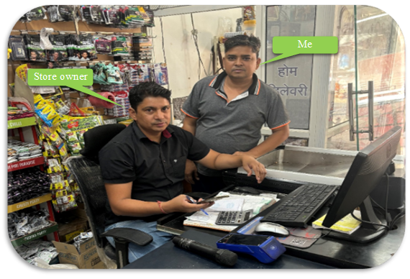

05. Recommendations
Increase the sales of High profit items
Increase the sales of low revenue items
Restock inventory in accordance with sales
Increase current ratio
Effective pricing adoptation
Store’s visuals enhancement
Many thanks to Mr. Ramesh for providing me opportunity to work for his store. I am grateful for his constant support. Last but not the least, I am thankful to IIT-Madras from the core of my heart for bringing up this course as this project instilled confidence in me to solve real world problems. Thank you!...

